Slide 1



Slide 2
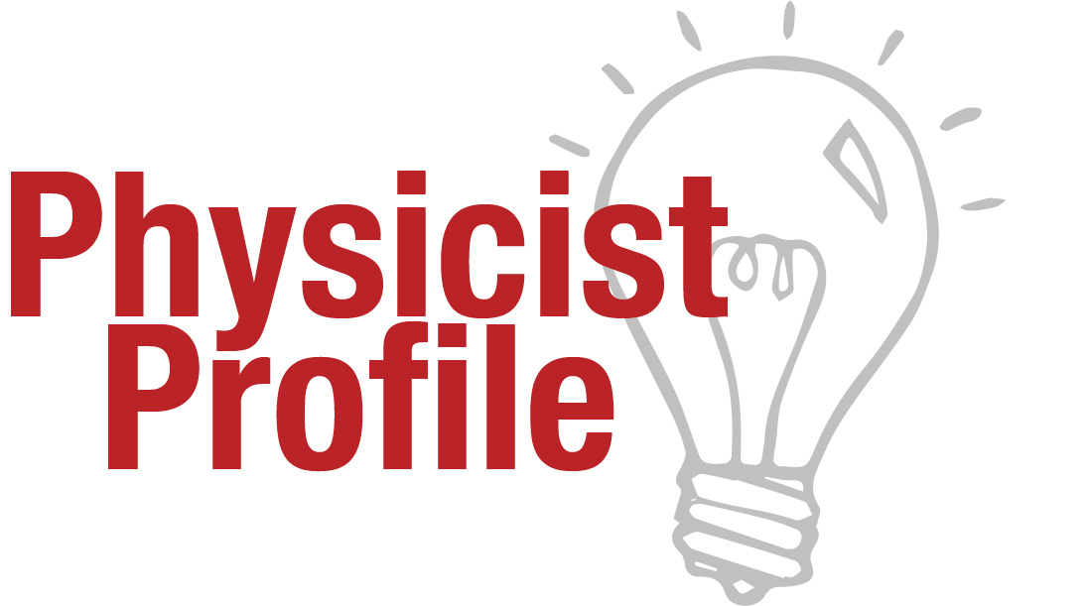

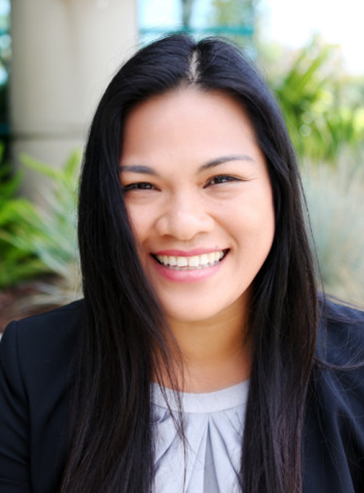
December found a job at a biotech startup straight out of college. She traveled to several countries to teach science and English and to support humanitarian work. This fueled her passion for a career in global development with strong social responsibility.
Now, December is a project manager working on a device to treat brain aneurysms and strokes!
Learn more: go.aps.org/deeperInSight

Slide 3
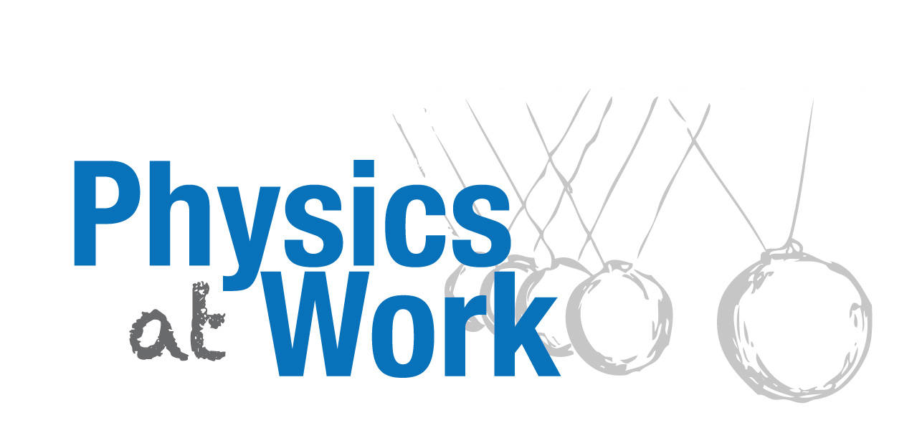

Critical thinking and ability to quickly integrate difficult concepts
Developing and managing budgets
Collaboration and communication with multiple teams
Working and communicating with stakeholders
Managing projects and staff
Learn more: go.aps.org/deeperInSight

Slide 4
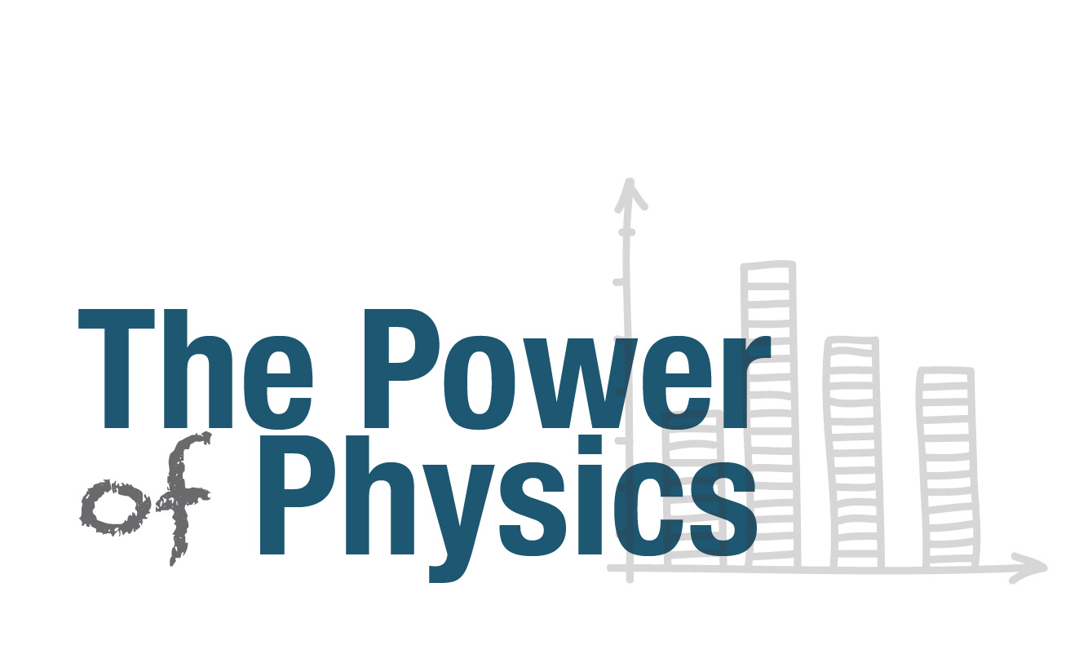

aip.org/statistics
Learn more: go.aps.org/deeperInSight

Slide 5
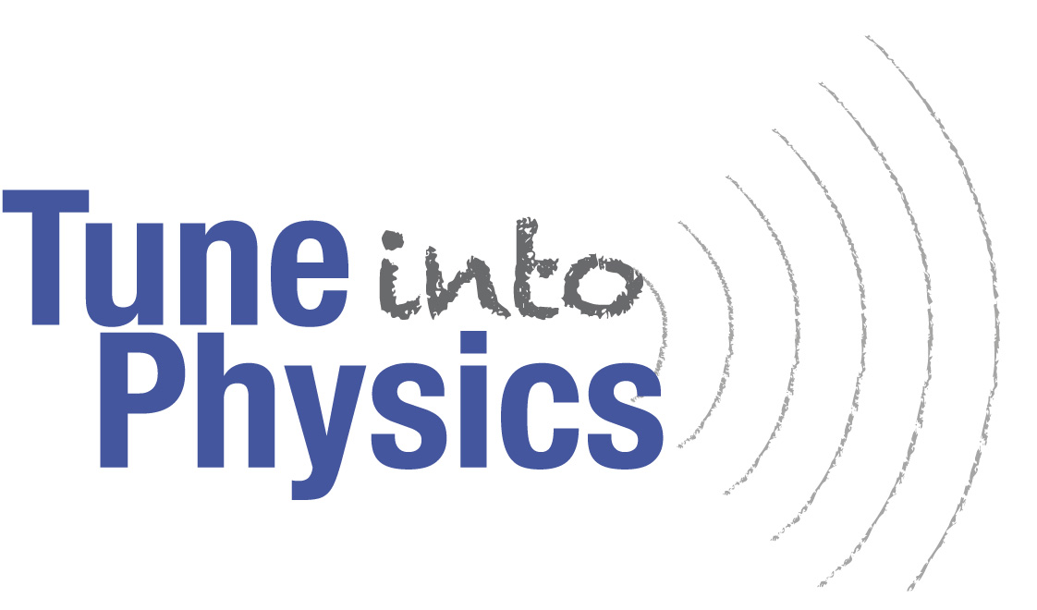
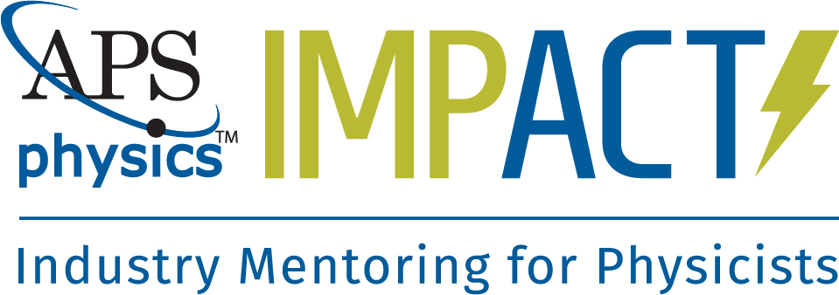

Want to prepare for a real-world job?
IMPact connects you with an industrial physicist who can provide advice, information, and guidance for pursuing an industry career.
Visit impact.aps.org to:
Register as a Mentee
Search for a Mentor
Manage your account
Learn more: go.aps.org/deeperInSight

Slide 6
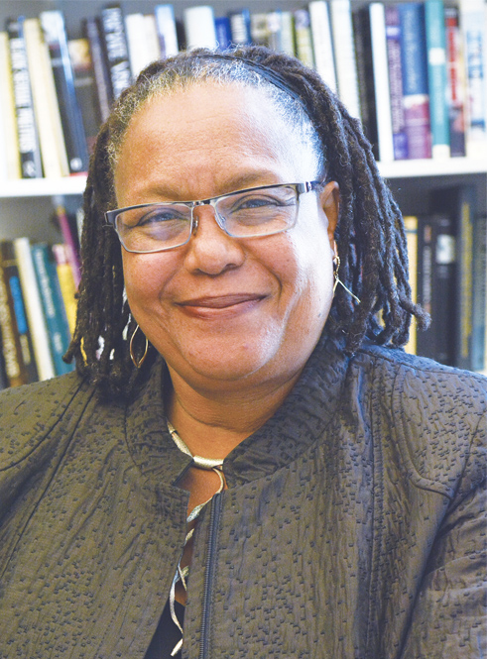
After getting a Master’s from MIT, Evelynn worked as a software engineer. Craving a deeper understanding of technology and its impact on society, she pursued a PhD in the history of science.
Currently, Evelynn conducts research on the intersections of science, technology, race, and gender and has served as a dean at Harvard University!
Learn more: go.aps.org/deeperInSight

Slide 7
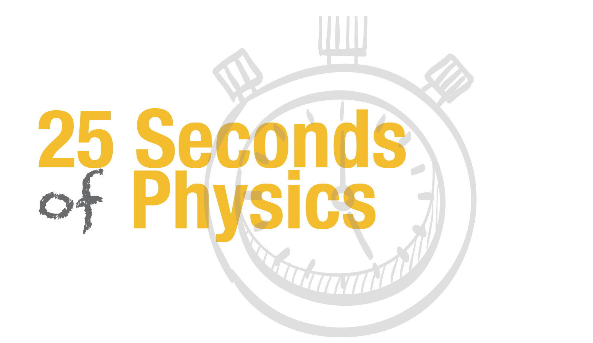

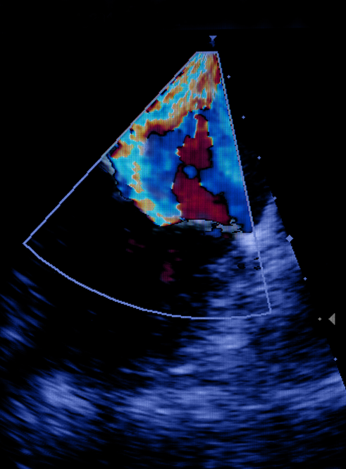
An ultrasound uses sound waves sent and reflected in the body to create an image. In order for the wave to transmit smoothly from the probe, a gel is required.
MIT researchers have eliminated the gel use by pioneering new technology. Light Ultrasound initiates the sound wave with a laser pulse and detects the reflection using skin vibrations!
Learn more: go.aps.org/deeperInSight

Slide 8
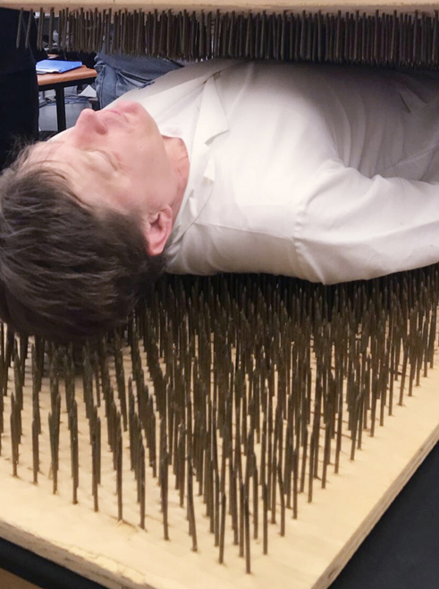
Combining his passion to give back to society with his love for physics, Thomas became a high school teacher. When teaching, he finds the physics material to be just as useful as the critical thinking skills taught in science courses.
Advice for students: Take different types of science courses and build communication skills through outreach activities.
Learn more: go.aps.org/deeperInSight

Slide 9

Creating lesson plans
Developing demonstrations and labs
Assessing and evaluating
Teaching and communicating
Critical thinking and problem solving
Learn more: go.aps.org/deeperInSight

Slide 10


Like teaching? Did you know that you can get a job almost anywhere in the U.S. or abroad as a science teacher?
Visit getthefactsout.org to:
Learn about how to become a teacher
Get facts and data about teaching
Find other great resources
Learn more: go.aps.org/deeperInSight

Slide 11
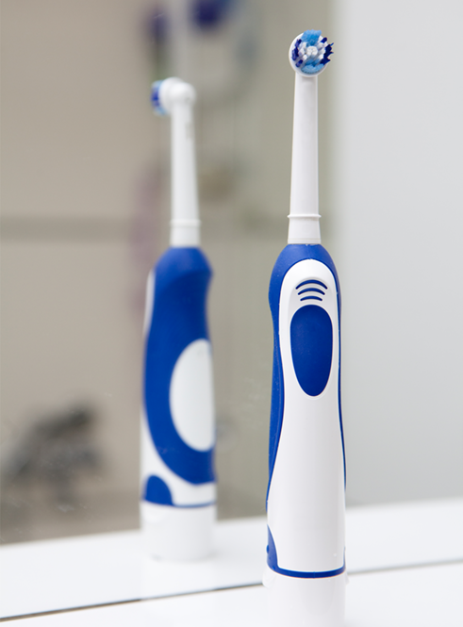
The alternating current from a wall outlet goes through a coil in the toothbrush holder, producing a magnetic field with field lines coming in and out of the holder.
This magnetic field induces an alternating current in another coil inside the toothbrush, which gets converted to a direct current, ready to charge the battery!
Learn more: go.aps.org/deeperInSight

Slide 12
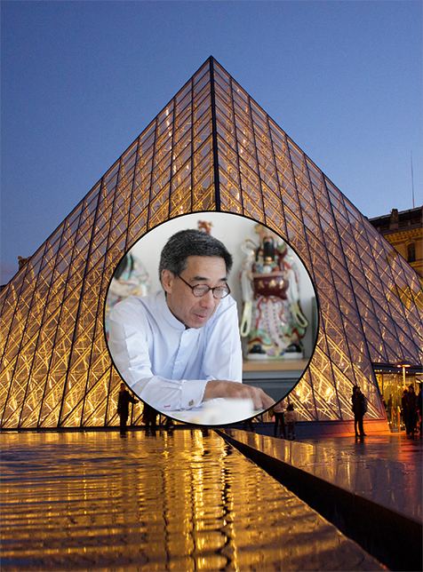
Obtaining a bachelors in physics while also taking and appreciating art classes led Didi to pursue a Masters in architecture. He gained a sense of practicality as well as evaluation skills from his physics training that help guide his work.
Didi has contributed to designs all over the world, including the Grand Louvre in Paris!
Louvre: Benh Lieu Song
Learn more: go.aps.org/deeperInSight

Slide 13

Want to know what’s going on in physics, who’s doing what in physics, and the physics of everyday things?
Follow Physics Central on Twitter: @PhysicsCentral
Like our Facebook page: facebook.com/PhysicsCentral
Learn more: go.aps.org/deeperInSight

Slide 14

Common themes for career success included hard work, persistence, education, problem-solving and interpersonal skills, while the most common barrier to success in the private sector was reported to be lack of interpersonal skills. [Source: aip.org/statistics]
While a physics PhD provides excellent technical training, the private sector also greatly values interpersonal skills!
Learn more: go.aps.org/deeperInSight

Slide 15
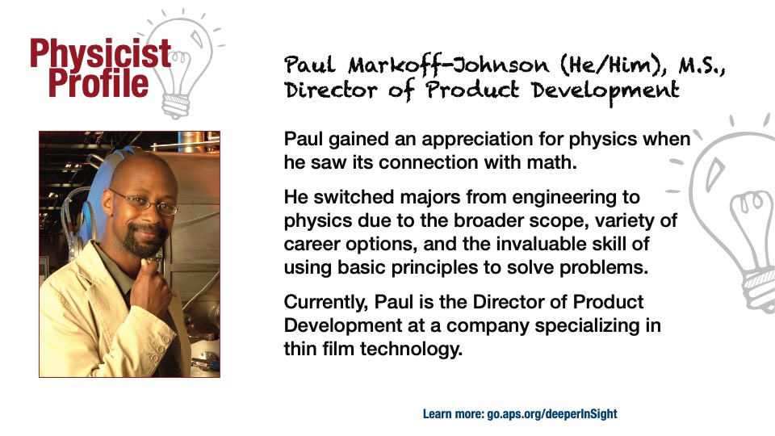

Slide 16
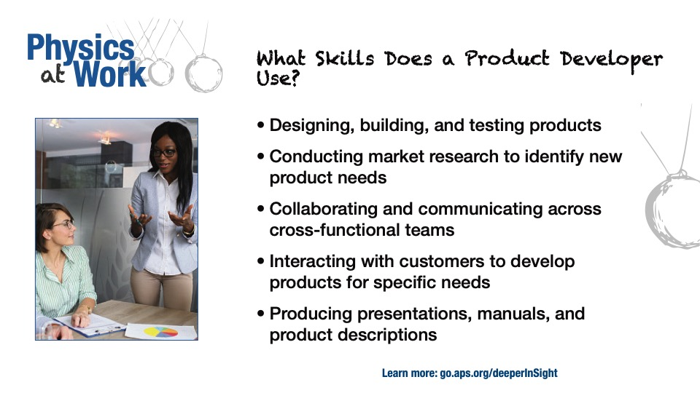

Slide 17
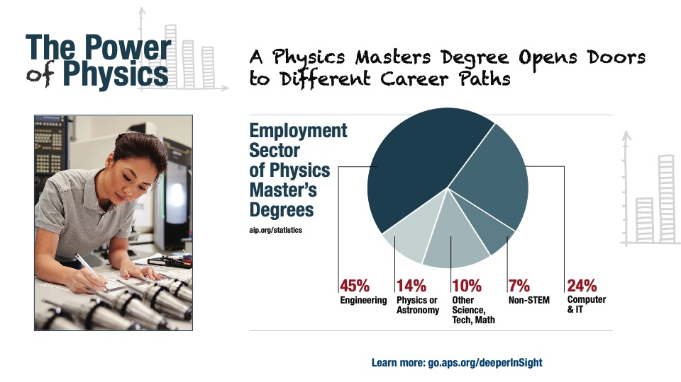

Slide 19
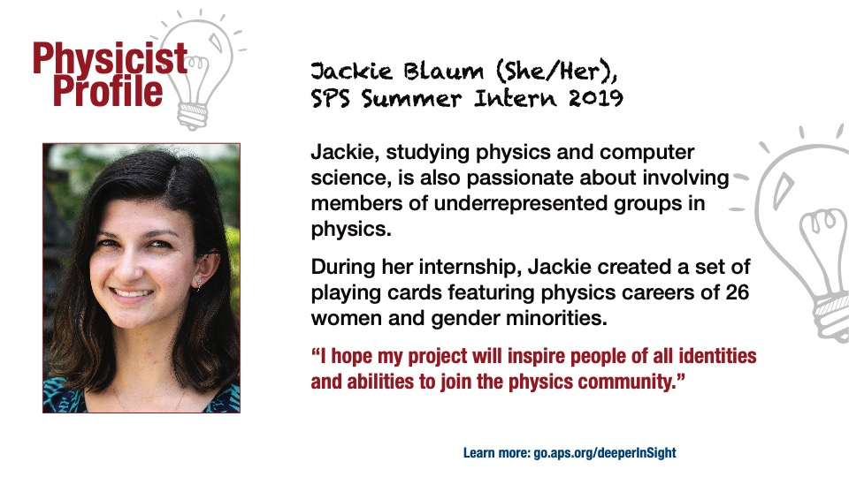

Slide 20
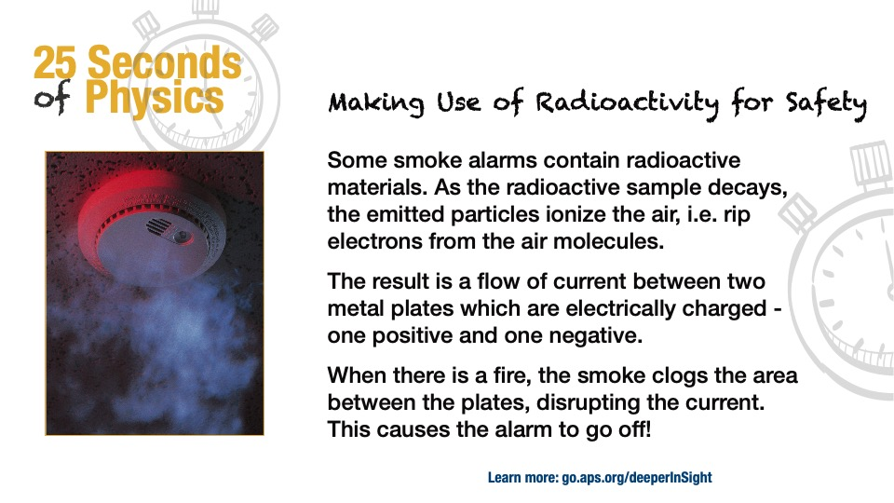

Slide 21
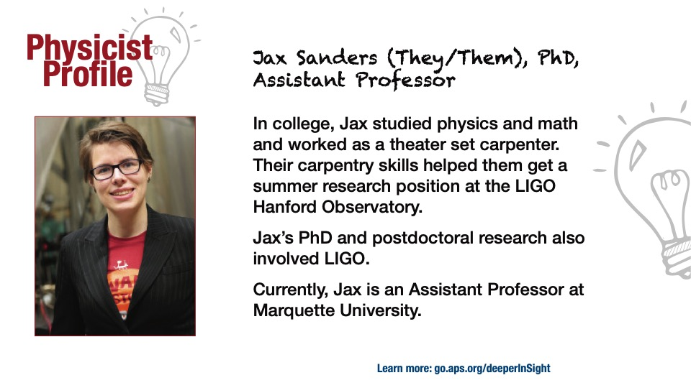

Slide 22
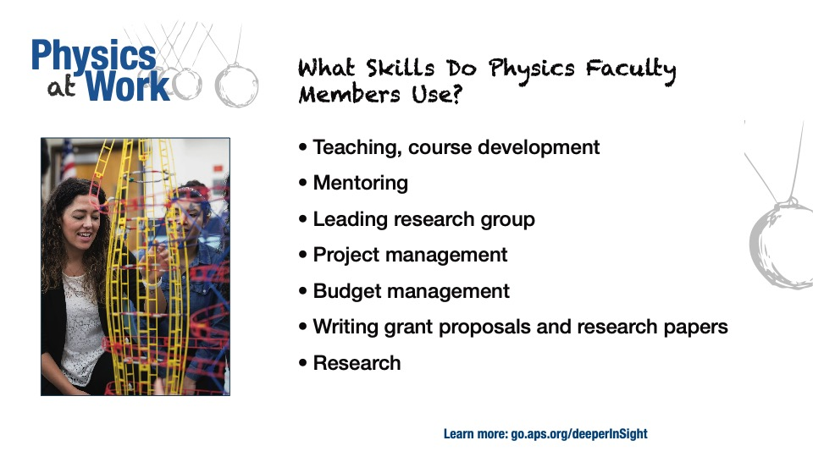

Slide 23
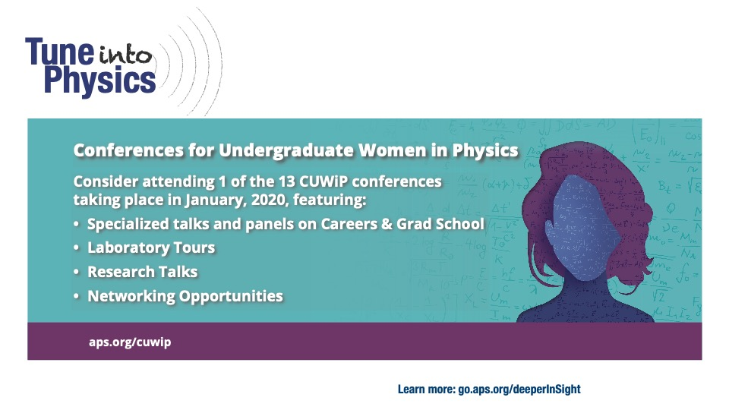

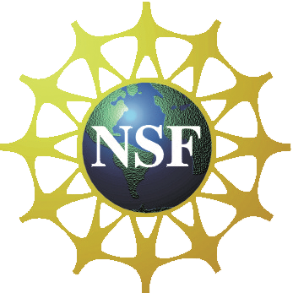

Slide 24
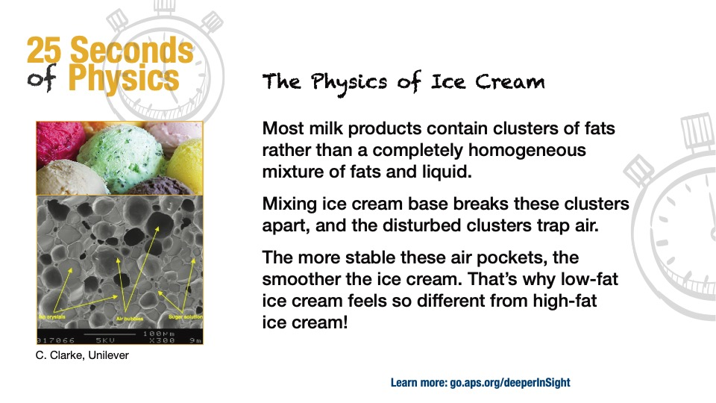

Slide 25
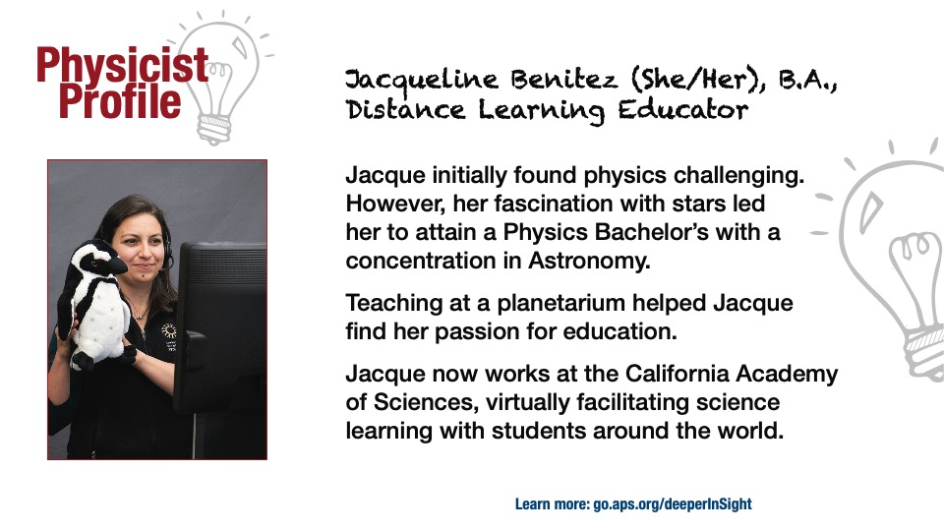

Slide 27
